Slide 1
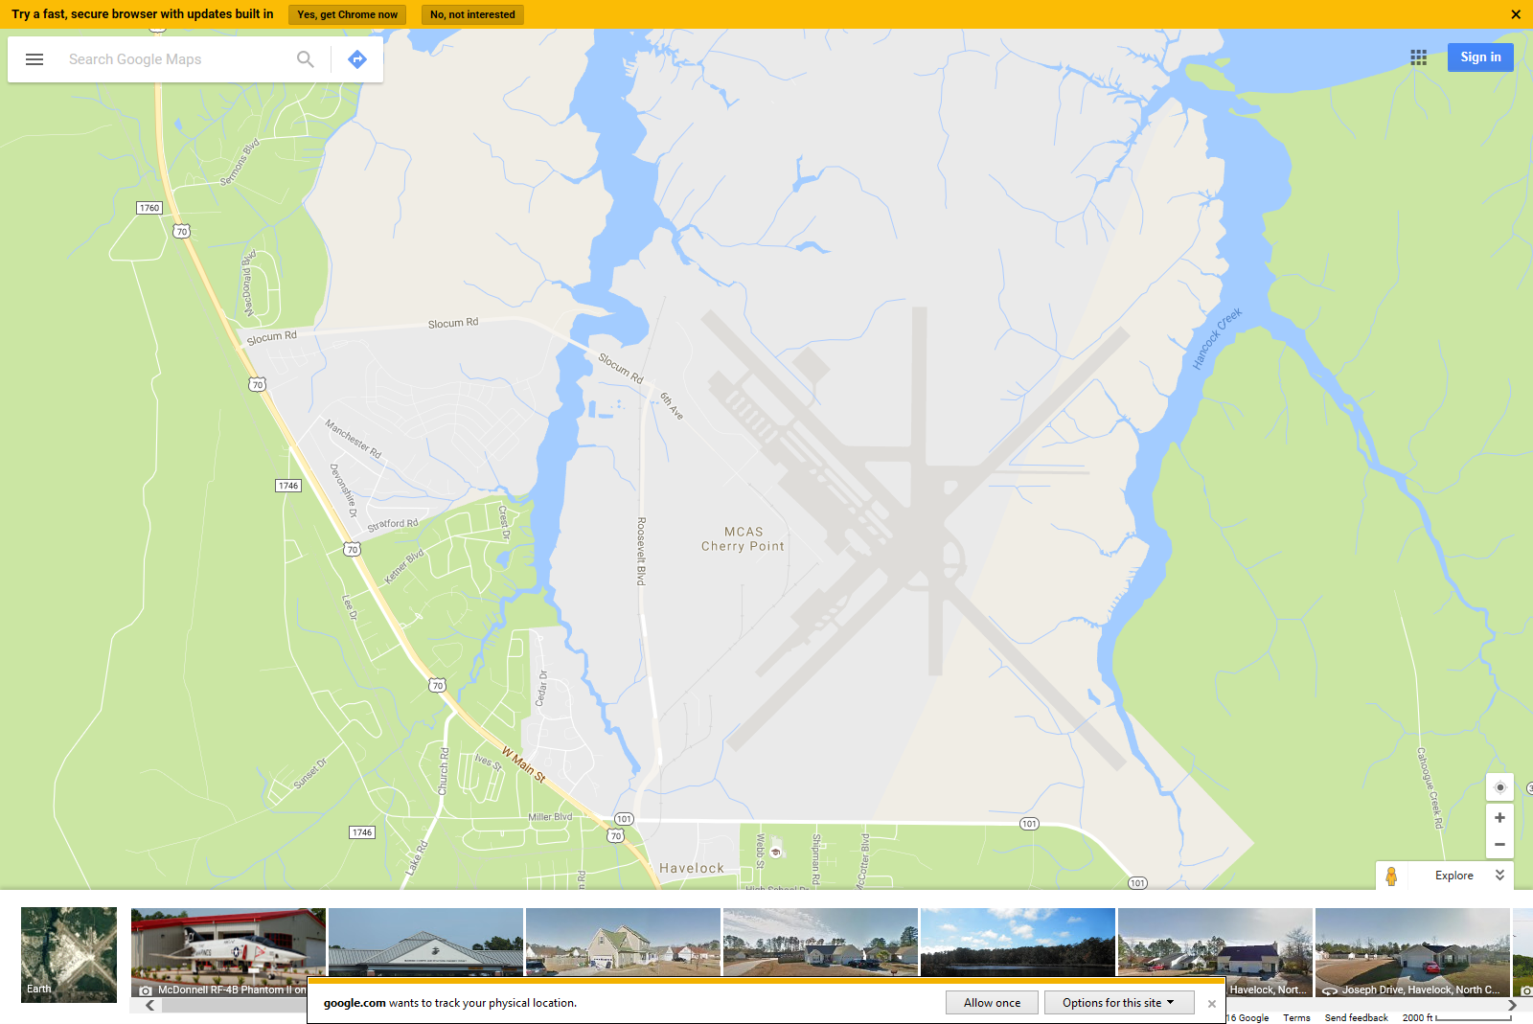
From New Bern
Slocum Gate
Main Gate
Notes:
Depending on the time of day, enter the base using either the Slocum Gate (weekdays 0600 – 2200, weekends 0600 – 0100) or the Main Gate (24 hours).

Slide 2
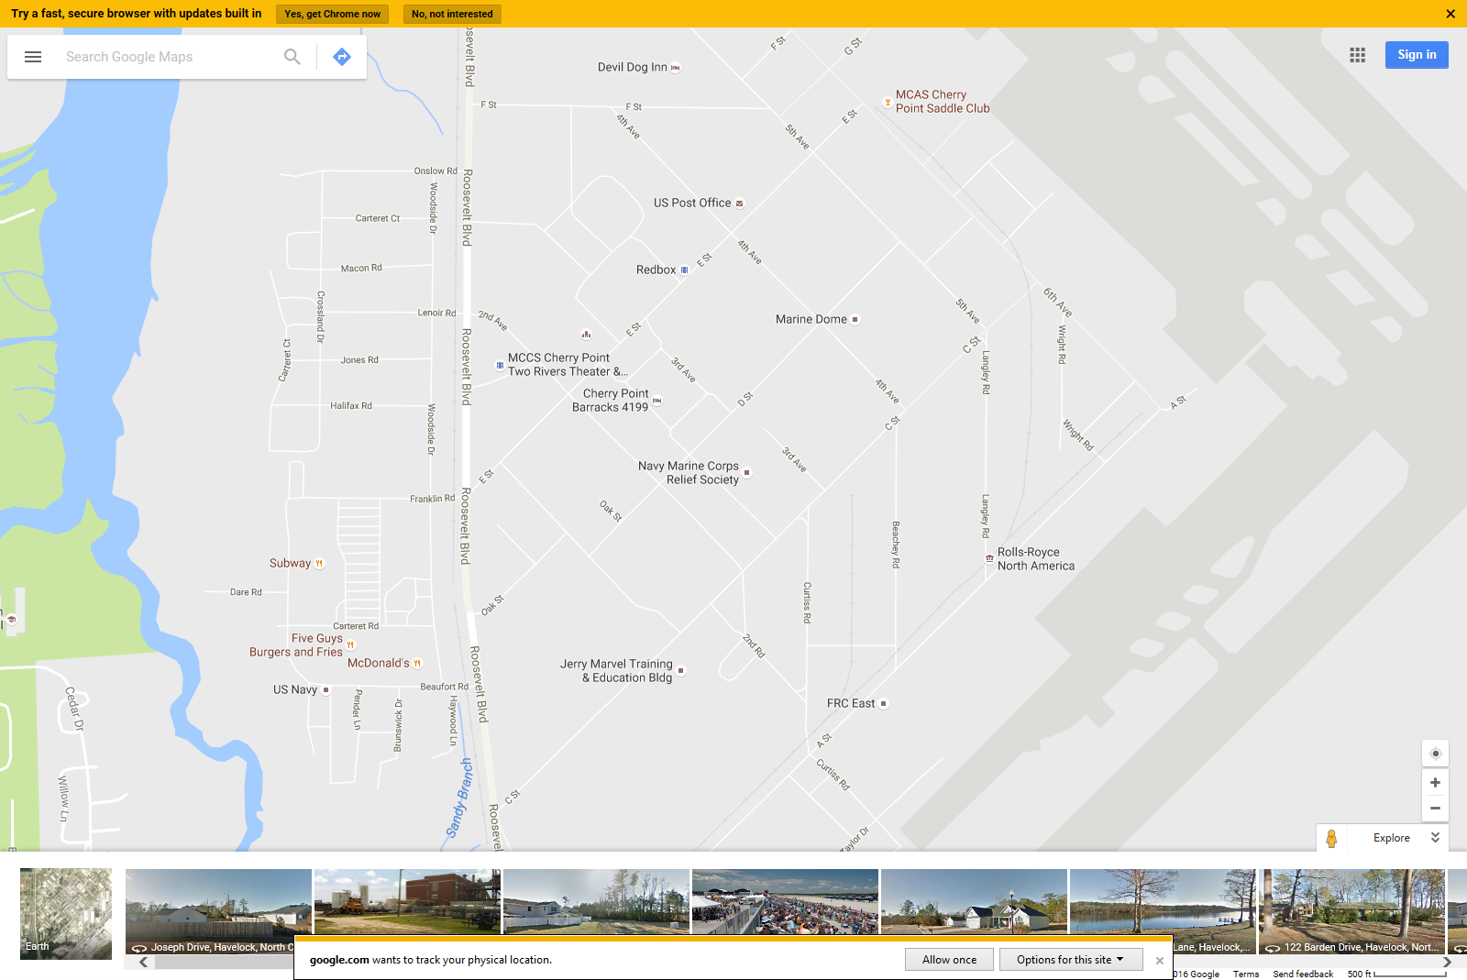
Ball
Fields
Lemon
Lot
Bldg 4414
BLDG 4414
MESS
HALL
4167
Notes:
Navy E4 and above will stay at the Devil Dog Inn. Check in with the duty in barracks 4867.

Slide 3
Ball
Fields
Lemon
Lot
Bldg 4414
BLDG 4414
MESS
HALL
4867
Notes:
All Marines students and Navy E3 and below will check in and reside in Barracks 4867.

